Slide 1
Analysis and Calculation of DC-Link Current and Voltage Ripples for Three-Phase Inverter With Unbalanced Load
The paper invesitages RMS DC link current considering and ignoring high frequency component of output current.
Also, it invesitagates dc-link current at balanced and unbalanced load.
It observes that unbalance system has double fundamental frequency component and the component is actually created by negative sequence of the current.
(look at reference 5 for double Fourier series analytical model)

Slide 2
DC current comes from input and other harmonics are attenuated by input filter.
It say that bigger capacitor brings that higher cost and bigger volüme and also smaller capacitor means that PWM process is disturbed even feedback control is there.
DC-link current is calculated:
RMS or Fourier series (look at references [11]-[18])
Fourier ➔ switching functions and load
➔ Also, convolution

Slide 3
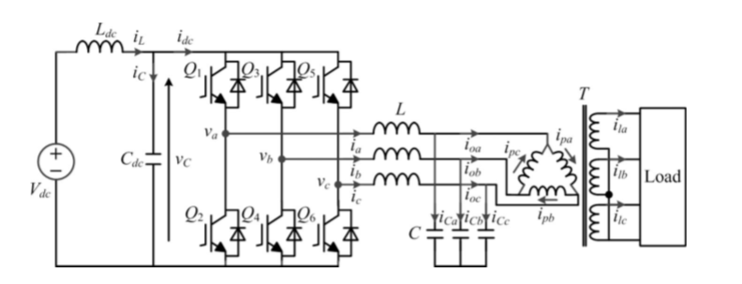
Non-linear loads and unbalanced load, analytical calculation (ref 19)
DC voltage is taken constant.
Delta connection gives third harmonic currents are trapped inside.

Slide 4
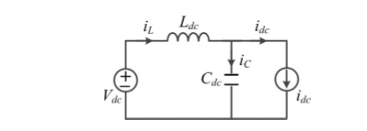

Equaivalent DC link model.
DC current is only drawn by Vdc
The switching function is binary: the switching function is 1 when the switch is turned ON, and the switching function is 0 when the switch is turned OFF.
One can note that the ripple of idc is high because of the frequent jumps between the output currents and zero

Slide 5
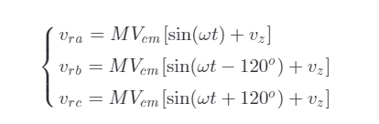
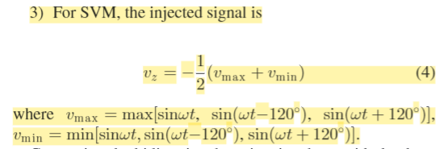
vz is the signal, which is injected into the three reference signals.

Slide 6
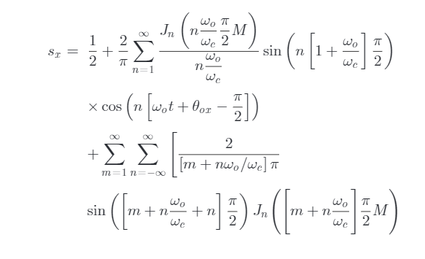

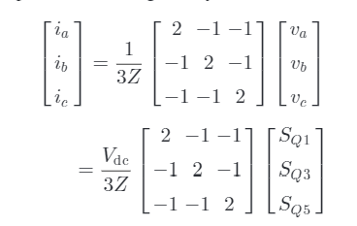

Switching functions is given for symetrical sampled functions.
Carrier frequency and its multiplies are attenuated significantly when the order rises.
Also, baseband harmonics, near the carrier frequency attenuated significiantly.

Slide 7
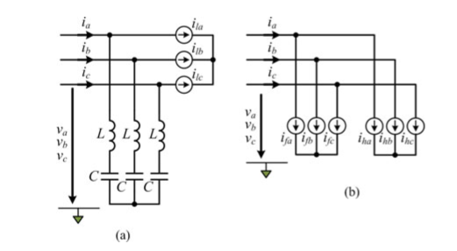
The definition of the imbalance is based on the difference between the maxi-mum phase load and the minimum phase load (look at ref 20)
The output currents is divided into three fundamental sinu-soidal current sourcesifa,ifb, andifc , and three high frequency harmonic currentsiha,ihb, andihc .

Slide 8
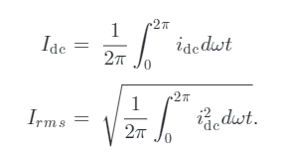
Switching functions an d output current have similar spectral characteristic.
it can be seen that the dc-link average and rms currents between considering and ignoring high frequency harmonic cur-rents have little difference, regardless of the load conditions.

Slide 9
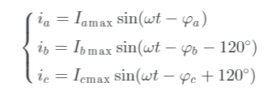
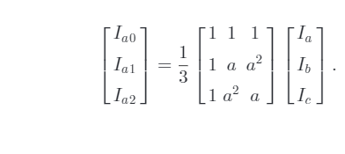
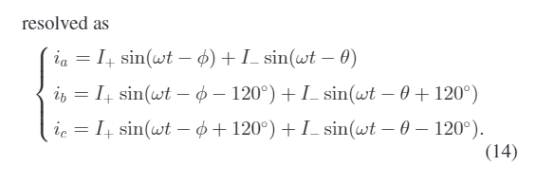
Linear load and ignoring high frequency part
In accordance with the symmetrical components method, the three-phase output currents can be resolved into three sets of symmetrical components: positive-sequence, negative-sequence, and zero-sequence.
As a result, the general three-phase output currents can be separated into three balanced and uncoupled networks
Only positive and negative sequence,
No zero sequence

Slide 10
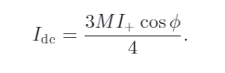
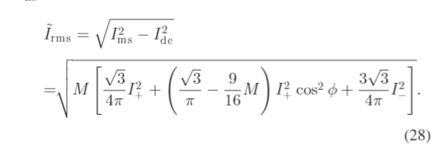

For balanced system, only high frequency and DC part.
For no load condition
Phi is equal to -90 (capacitor )
modulation index, positive-sequence component, negative-sequence com-ponent, and power factor.
double fundamental frequency harmonic and high frequency harmonic
The average component ofiC is zero because the impedance of the capacitor is infinity for the dc frequency.
The dc-link capacitor almost carries all harmonics of the dc-link current, including the double fun-damental frequency harmonic.

Slide 11
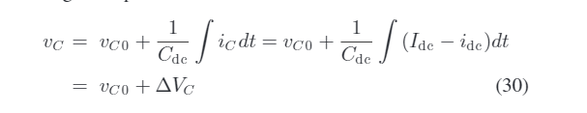
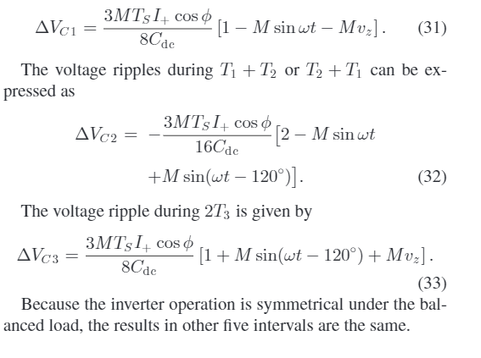

the maximum modulation index is used to design the dc-link capacitor.
For balanced load condition , negative sequence is zero.
Unbalanced load
dc-link capacitor is in inverse proportion to the dc-link volt-age ripple. It means that the larger the dc-link capacitance is, the smaller the dc-link voltage ripple is, and vice versa

Slide 12
Moreover, it is shown that the dc-link harmonic rms current decreases with the increase of the modulation index, and however, the dc-link average current is directly proportional to the modulation index. In addition, it can also be found that the dc-link harmonic rms and average currents reduce with the drop of the output power.
Output can be taken as only fundamental components. Not required high frequency components.
Unbalanced load has double fundamental frequency harmonic, apart from high frequency harmonics.

Slide 13
Deduction:
For analytical calculation output current can be divided positive and negative sequence. Thus, the ripple of high frequency and double fundamental can be found.

Slide 15
Analysis of dc-Link Voltage Switching Ripple in Three-Phase PWM Inverters
Dc-link capacitor as a function : operating conditions such as the modulation index and the output current amplitude.
Nonideal voltage source(dc source impedance) with balanced load

Slide 16
In a non-ideal or practical dc voltage supply, such as a battery, photovoltaic module, fuel cell, or even the dc-DC converter or PWM rectifier, due to the presence of a series dc impedance, a voltage ripple appears on the dc-link if a switching current ripple circulates through the capacitor
Fourier analysis and corresponding root mean square (RMS) calculations
Look at ref 13-14-15-16-17
the peak-to-peak dc voltage ripple envelope is analytically defined as a function of the output current amplitude, its phase angle, and the modulation index over the fundamental period.

Slide 17
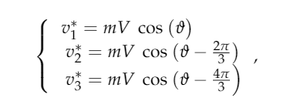
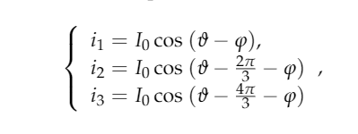


Balanced and neglecting ripples
Ripple has high frequency if balanced load
Neglecting losses , ideal case

Slide 18
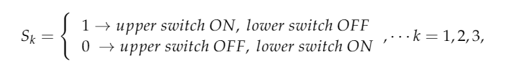


Due to the symmetry of the inverter input current, the analysis can be limited to one-sixth of the fundament period (T/6 or 60)
which corresponds to carrier-based PWM with a min/max common-mode signal injection, is considered as a nearly optimal modulation for the output current THD.

Slide 19



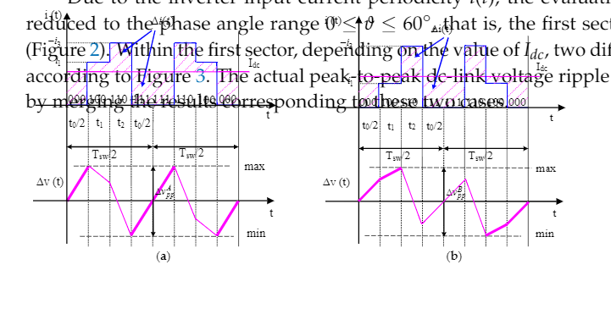

Slide 20

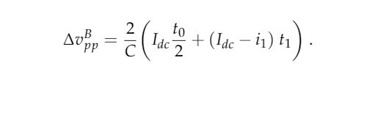
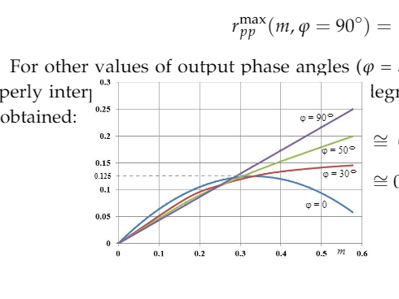
For i1>idc
For i1<idc

Slide 21
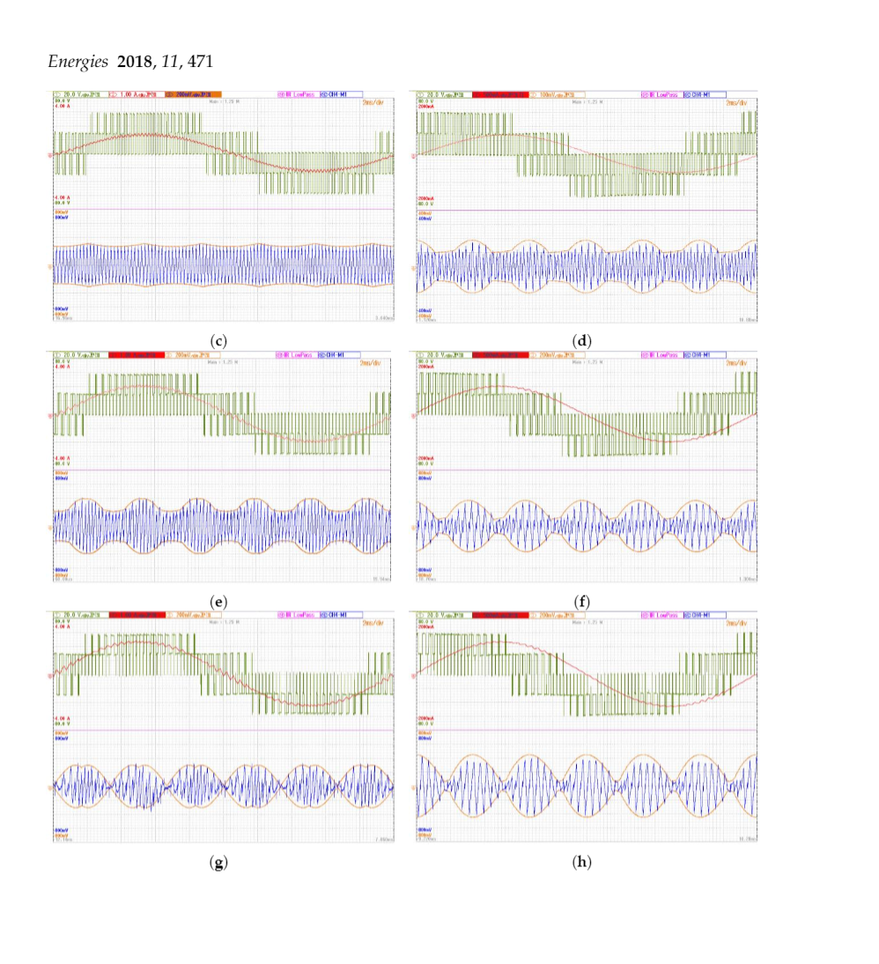
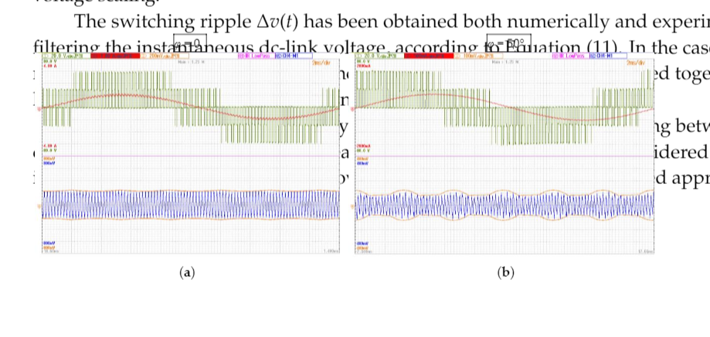
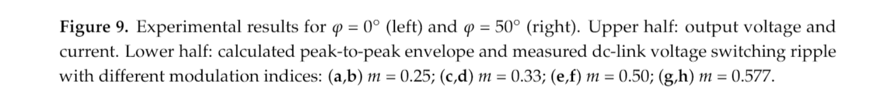

Slide 22
Specifically, the peak-to-peak dc voltage ripple is analytically defined as a function of the output current amplitude, its phase angle, and the modulation index over the fundamental period
Space vector modulation analytical calculation

Slide 24
Analysis of the DC-Link Current Spectrum in Voltage Source Inverters
dc-link current of single- and three-phase voltage source inverters
harmonic components produced by balanced and unbalanced loads, defining positive, negative and zero sequence component
For motoring load, unbalance is typically few percent. However, such UPS system it may be higher.

Slide 25
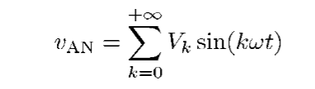

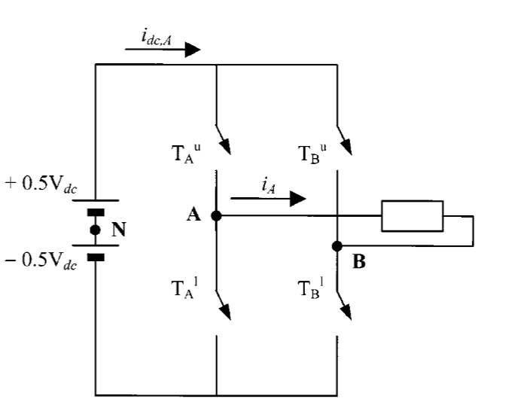
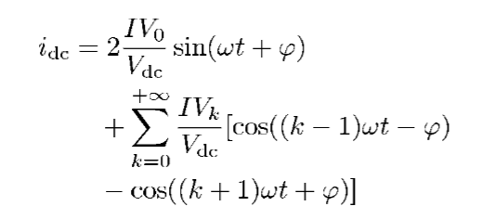

Slide 26
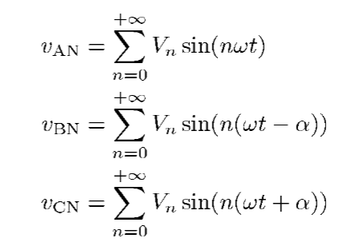
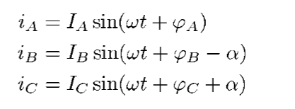

Slide 27
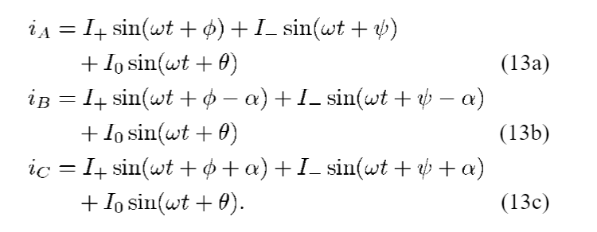
It may be noticed from (17) and (19) that low-order harmonics appear in the dc-link current spectrum when the load is unbalanced, as a result of intermodulation between the output voltage waveform and the non null negative and zero sequence compo-nents
The negative sequence create double fundamental
Also, zero sequence creates double fundamental frequency. However, the magnitude is reduced.

Slide 29
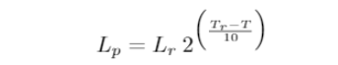
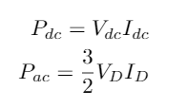


Analytical method to calculate the DC link current stress in voltage source converters
RMS value of current ➔ temperature of capacitor
A simplified life time ➔
Time domain analysis with only fundamental line current ➔ give error
Frequency domain Double Fourier series
d-axis component

Slide 30


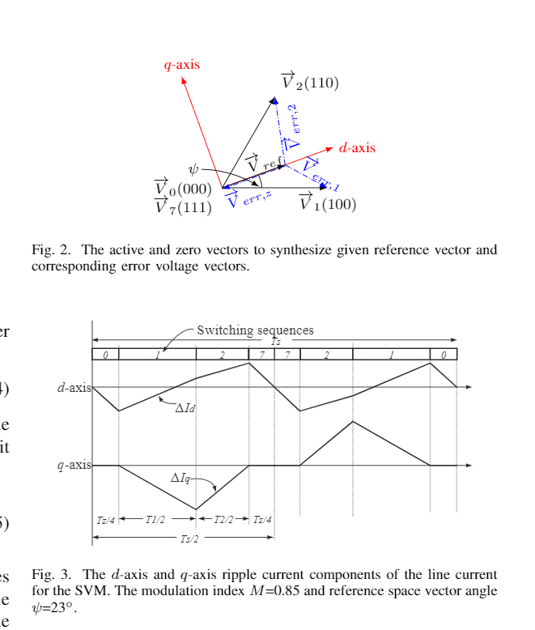
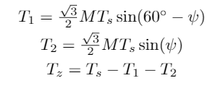
dwell time ??

Slide 31

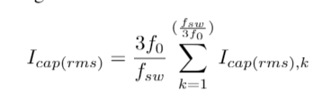
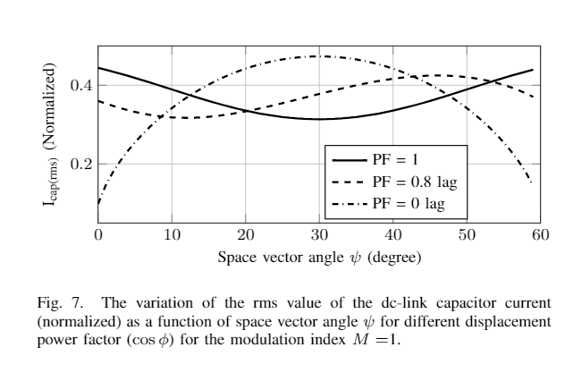
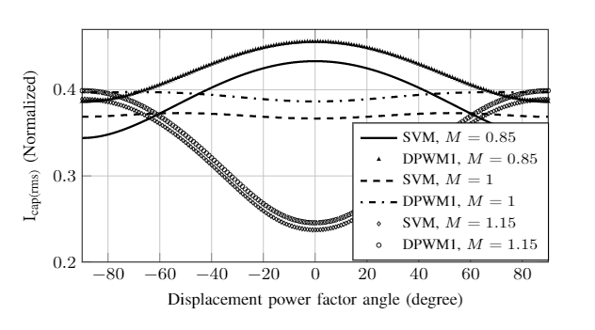
mod-ulation indexM , the displacement power factor angle, and the PWM scheme used.

Slide 33
Input Current Ripple Analysis of Nine-Phase PWM Inverters

